Slide 1

Applied Uplift Modeling with Meta-Learners
Senior Capstone
UW Oshkosh
Master of Science in Data Science
By Shelby Temple
5/3/2020
These slides are intended to be readable.

Slide 2
Applied Uplift Modeling with Meta-Learners | Problem Setup
Introduction
Synthetic Data Generation
Uplift Modeling
Conclusions
Relevant Marketing Problems:
The Classic Approach:
Lead Optimization: A company has a lead database but they generate more leads than can be worked and a lot of the leads are a waste of time – currently agents can work the leads in any order they choose
Cross-Sell: A company wants to run a cross-sell campaign and the assumption is they don’t want to cross-sell to their entire customer base because some people may not need or want the other products
Retention: A company wants to reach out to customers who are about to churn and save them
✓ Lead Optimization: Build a propensity model that can predict if customers will purchase soon – order the audience by the predicted probabilities from high to low
✓ Cross-Sell: Build a propensity model that predicts the likelihood a customer will purchase the cross-product – target the segment that has a high propensity and hasn’t purchased the product yet
✓ Retention: Build a propensity model that predicts which customers are about to churn soon, attempt to save the customers that are high risk to churn. Also good to incorporate customer value to help inform priority

Slide 3
Applied Uplift Modeling with Meta-Learners | Propensity Scores
Introduction
Synthetic Data Generation
Uplift Modeling
Conclusions
The question propensity models answer:
“How likely is the customer going to do something in the future?”
What a propensity model might miss when used for an advertising campaign:
“Did my advertising cause the customer to purchase from me?
“Did I waste money on advertising to customers who were already going to purchase from me?”
“Did my advertising make the probability of someone purchasing worse (negative impact)?”

Slide 4




The Classic Uplift Segments
Already happy and satisfied!
Interested but on the fence.
Sure Things
Persuadables
Moving on no matter what!
I dislike advertisements in this channel!
Lost Causes
Sleeping Dogs

Slide 5
The Classic Uplift Segments
Will reach the outcome no matter what.
❌ Save time and money by not targeting.
The treatment will cause them to act. Truly incremental conversions.
✓ Target as many persuadables as possible.
Sure Things
Persuadables
Will never reach the outcome even with the treatment.
❌ Save time and money by not targeting.
Will be less likely to purchase with treatment.
❌ Prevent negative effects.
Lost Causes
Sleeping Dogs

Slide 6
Applied Uplift Modeling with Meta-Learners | Propensity Scores
Introduction
Synthetic Data Generation
Uplift Modeling
Conclusions
The question uplift models answer:
“Will the treatment (t) impact the customer to do (y) given what we know about them (x)?”
“What was the incremental impact from the advertisement to cause the purchase for an individual?”
What makes uplift models more tricky to implement:
It uses machine learning and causal inference
Machine learning for predictions
Causal inference to simulate the customer both seeing and not seeing an advertisement – in reality we can only know one of these scenarios
Existing machine learning algorithms are built to use features (x) to predict a target (y)
Techniques for feature selection, model selection, and hyperparameter tuning aren’t setup for uplift

Slide 7
Applied Uplift Modeling with Meta-Learners | Different approaches
Introduction
Synthetic Data Generation
Uplift Modeling
Conclusions
Traditional Propensity Model
Direct Uplift Models:
Meta-Learners:
Description
Using features to simply predict how likely an outcome might be.
Example
Building a logistic regression model to predict the probability someone will purchase insurance.
Pros
Easy to implement
Will likely do better than random by eliminating the lost causes segment
Cons
Does not consider incrementality
Does not consider negative treatment impacts
Description
Building new algorithms that can directly predict uplift.
Example
Using R Uplift package to build a causal conditional inference forest which directly predicts treatment effects
Pros
Most likely to give the best and most accurate results
Cons
Extremely slow even on smaller datasets
Mostly limited to uplift forests (no uplift XGB or uplift neural net)
Description
Tricks that transform the problem so you can indirectly estimate uplift using standard machine learning packages like XGB.
Example
Use causalML T-learner that decomposes the problem into a set of regression problems solved by XGBoost.
Pros
Much faster than direct uplift models
In many scenarios can get results that are comparable to direct methods
Cons
Each model has its own set of potential flaws created by the shortcuts or assumptions it makes

Slide 8
Applied Uplift Modeling with Meta-Learners | Uplift modeling synonyms
Introduction
Synthetic Data Generation
Uplift Modeling
Conclusions
Uplift Modeling | Estimating Heterogenous Treatment Effects | Net Scoring | Average Causal Effect Modeling | True Reponses Modeling
Uplift | Heterogenous Treatment Effects | Conditional Average Treatment Effect | Incremental Impact | True Response
Propensity Model | Gross Scoring | Classic Approach | Traditional Approach | Response Modeling
Two-model Approach | Independent Two Model Approach | T-learner
Single Model Approach | Treatment Dummy Variable Approach | S-learner
Modified Outcome Approach | Transformed Outcome Approach

Slide 9
Applied Uplift Modeling with Meta-Learners | Popular Meta-learners
Introduction
Synthetic Data Generation
Uplift Modeling
Conclusions
Single Model Classifier | Use treatment flag as a feature in the model. Train one model using full dataset. With new observation force treatment to 0 and get prediction, then force treatment to 1 and get a second prediction. Subtract the two predictions to get a proxy for uplift.
Two-Model Classifier | Dataset is broken out into treatment only and control only. Two independent classifiers are built on the target. For a new observation both models predict probability to convert. When subtracting treated prediction from control prediction you get a proxy for uplift.
Four-Quadrant Approach | Outcome is transformed into 4 levels to decompose to a multi-classification problem. Treated Response, Treated No Response, Control Response, Control No Response. Uplift proxy is calculated as: PTR (probability of treated and response) + PCN (probability control no response) – PTN (probability treated no response) – PCR (probability control and response)
Pylift Transformed Outcome T-Learner | Outcome is combined with treatment and random assignment percentage information to create a numeric value for regression estimation of uplift. Then it takes the two model approach but can use any regression algorithms to solve.
CausalML R-Leaner | Uses cross-validation estimates of outcomes and propensity scores to fit machine learning models. The R-learner get’s its name by the special optimization metric, R-Loss, it tries to minimize when running cross-validation.
CausalML X-Leaner | The X-learner is an extension of T-learner with some extra tweaks. It leverages the observed outcomes to impute the unobserved scenario. Every observation that was in the treatment group has its control outcome imputed and every observation in the control group has its treatment outcome imputed. The X-learner is then able to estimate the uplift in a second step as if both scenarios (both treated and not treated) were observed. The advantage over two-model is that the model can still use information from the control group to derive better estimators for the treatment group and vice-versa.

Slide 10
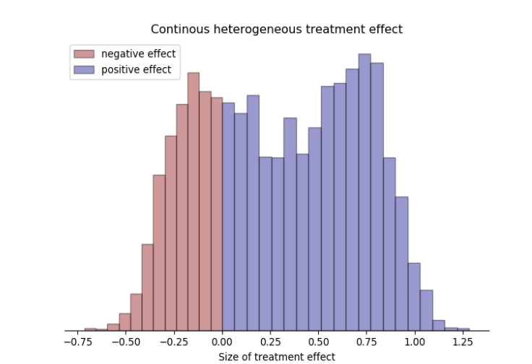
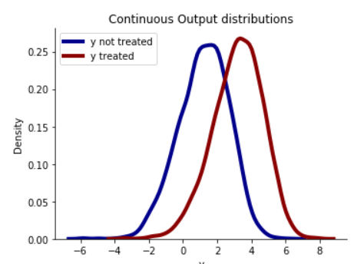
Applied Uplift Modeling with Meta-Learners | Synthetic Data Generation
Introduction
Synthetic Data Generation
Uplift Modeling
Conclusions
Why Synthetic Data
The Opossum Package
From the blogpost:
Need to test multiple different datasets to understand how the algorithms might respond to different scenarios
Synthetic datasets can have the ground truth labels created which makes validation easier—in the real world someone cannot both see and not see an advertisement so the ground truth labels are in part inferred
Getting multiple real world datasets perfect for the objective would have been difficult
User-friendly interface that allows for quick adjustment of data generation
Solid documentation on how to understand and use the package
Parameters that let you control the number and variety of features
It lets you choose between a binary or continuous target variable
You can control if the groups are randomly assigned and if the groups are imbalanced
The intensity and properties of the treatments effect
The relationship between the features and target and if there are interactions across the features

Slide 11
Applied Uplift Modeling with Meta-Learners | Synthetic Data Generation
Introduction
Synthetic Data Generation
Uplift Modeling
Conclusions
Basic Dataset
Complex Dataset
50,000 rows
10 features all intended to be useful in predicting
Feature types 6 numerical continuous 4 binary categorical
The intensity of the lift was set to high
Probability of an observation exposed to advertisement was 50%
Relationship between features and target was linear with no interactions
The base propensity to convert in the future with no advertisement is 50%
90% of treatment effects were positive, with 6.6% of treatments having no impact and 3.3% of treatments having a negative impact
2 million rows
200 features with only 60 (30%) of then being useful--the rest as noise
40 features are numerical continuous and 20 are categorical with a mix of levels ranging from two to fifty
The intensity of the lift was set to high (10 on a scale of 10)
Probability an observation was exposed to an advertisement was 75%
The relationship between features and target was linear with no interactions
The base propensity to convert in the future with no advertisement is 3%
90% of treatment effects were positive, with 6.6% of treatments having no impact, and 3.3% of treatments having a negative impact

Slide 12
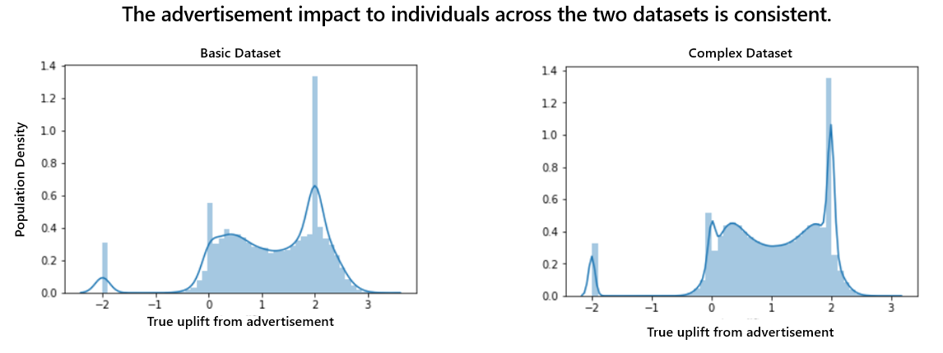
Applied Uplift Modeling with Meta-Learners | Synthetic Data Generation Treatment Effects
Introduction
Synthetic Data Generation
Uplift Modeling
Conclusions

Slide 13
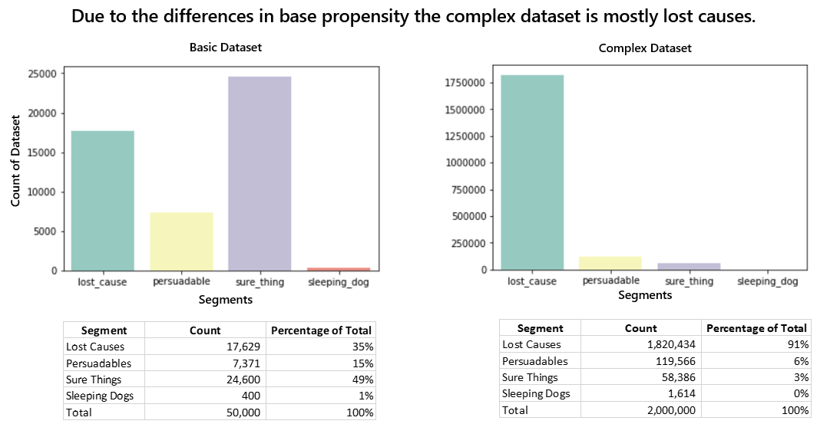
Applied Uplift Modeling with Meta-Learners | Synthetic Data Generation Segments
Introduction
Synthetic Data Generation
Uplift Modeling
Conclusions

Slide 14
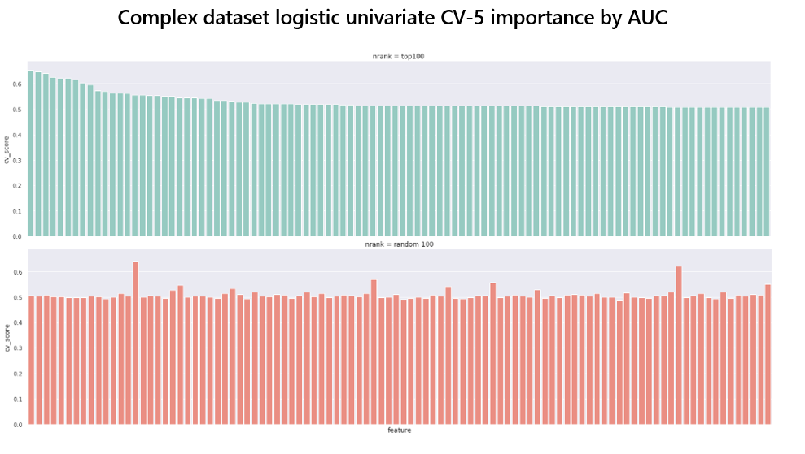
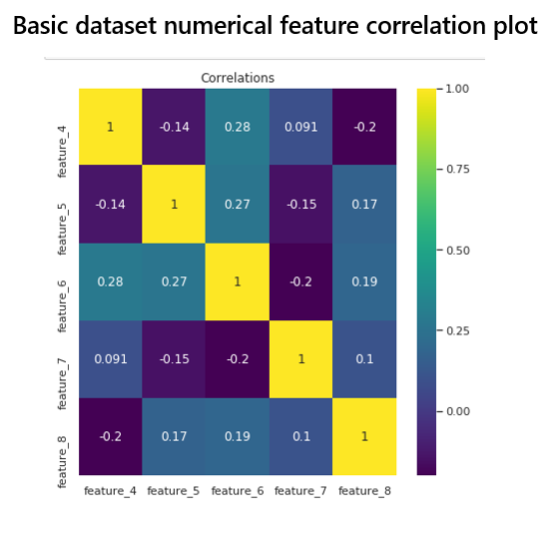
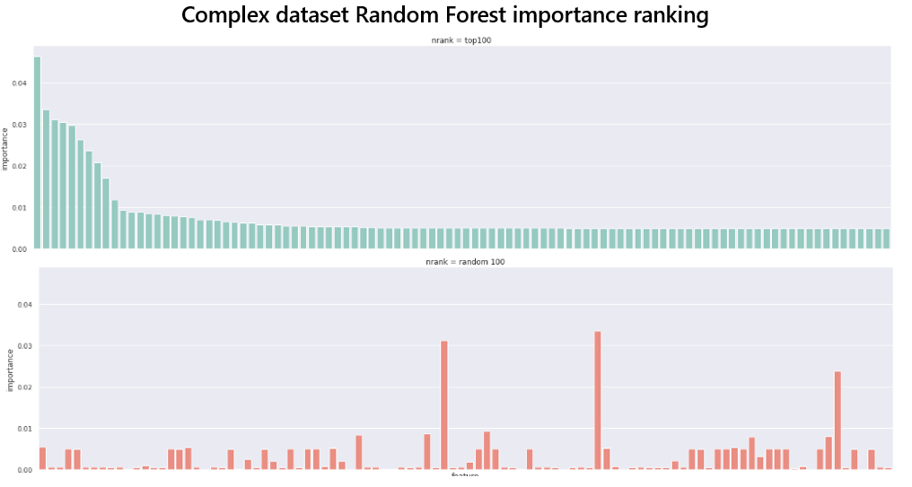
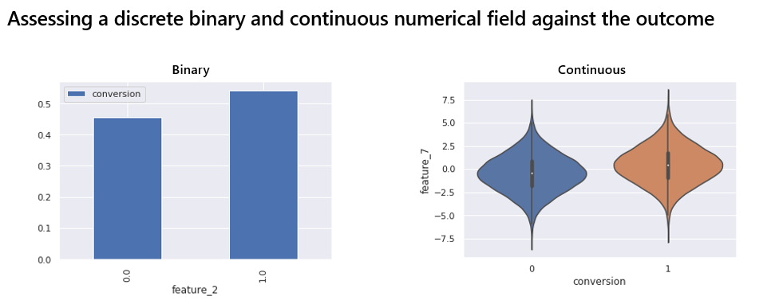
Applied Uplift Modeling with Meta-Learners | Synthetic Data Generation EDA and Feature Selection
Introduction
Synthetic Data Generation
Uplift Modeling
Conclusions

Slide 15
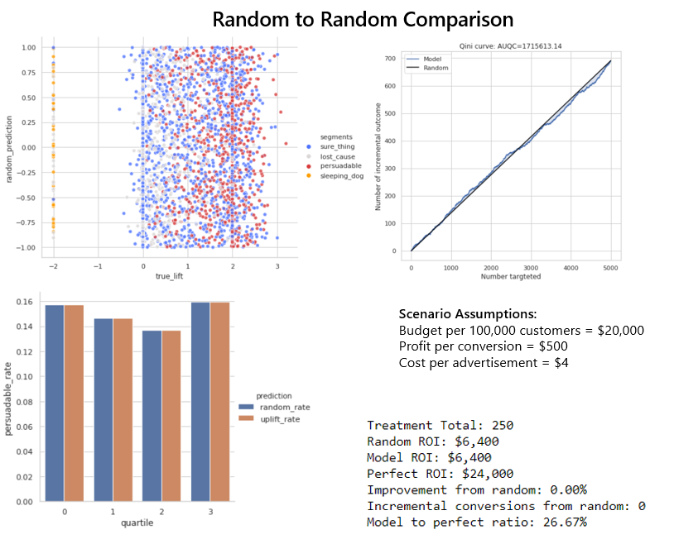
Applied Uplift Modeling with Meta-Learners | Basic Random Compared to Random
Introduction
Synthetic Data Generation
Uplift Modeling
Conclusions
Random performed similar to random
In hypothetical scenario, demonstrated a 0% improvement to ROI over random
The first quartile of targeting was finding persuadables at a 15.5% rate (0.5% greater than the overall distribution 15%)

Slide 16
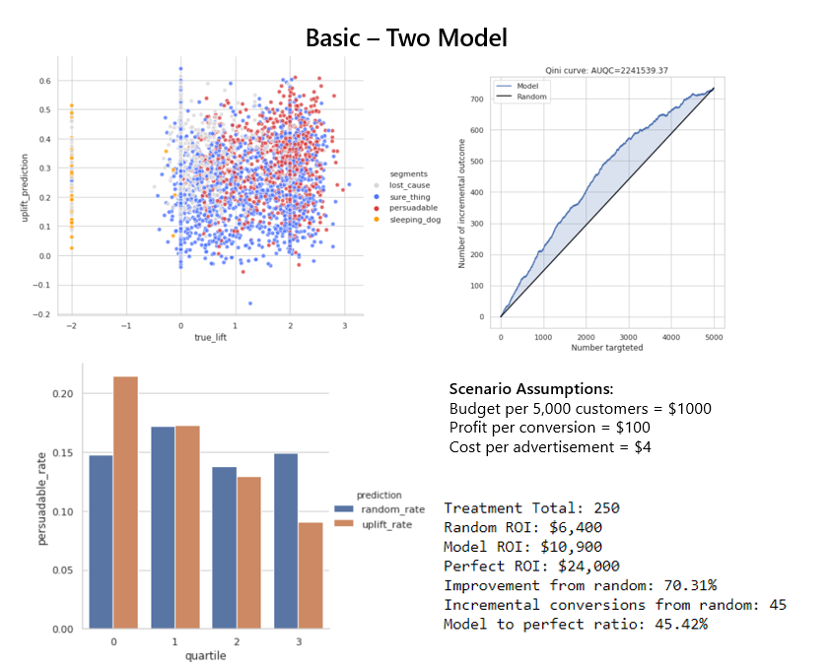
Applied Uplift Modeling with Meta-Learners | Basic (from scratch) Two Model Classifier
Introduction
Synthetic Data Generation
Uplift Modeling
Conclusions
Improved moderately over random targeting
In hypothetical scenario, demonstrated a 70% improvement to ROI over random
The first quartile of targeting was finding persuadables at a 22% rate (7% greater than the overall distribution 15%)

Slide 17
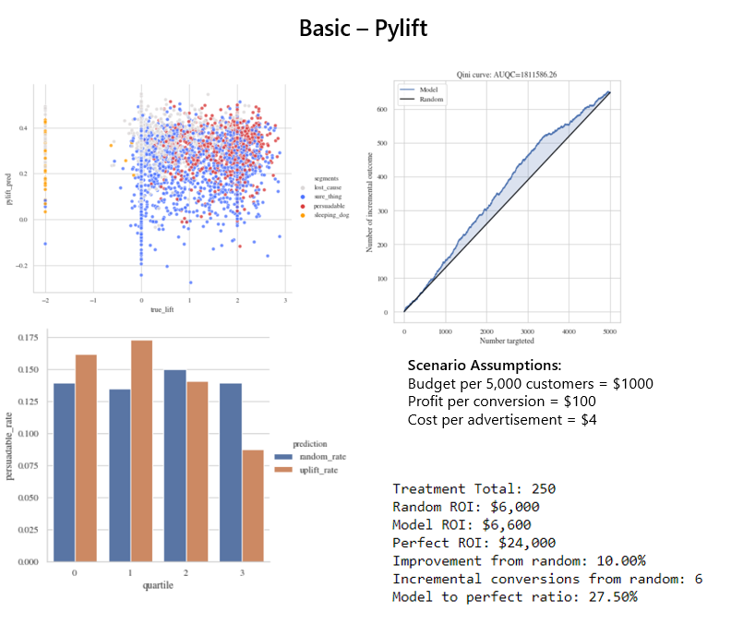
Applied Uplift Modeling with Meta-Learners | Basic Pylift – Transformed Outcome T-Learner w Tuning
Introduction
Synthetic Data Generation
Uplift Modeling
Conclusions
Did not perform much better than random
In hypothetical scenario, demonstrated a 10% improvement to ROI over random
The first quartile of targeting was finding persuadables at a 15.5% rate (0.5% greater than the overall distribution 15%)

Slide 18
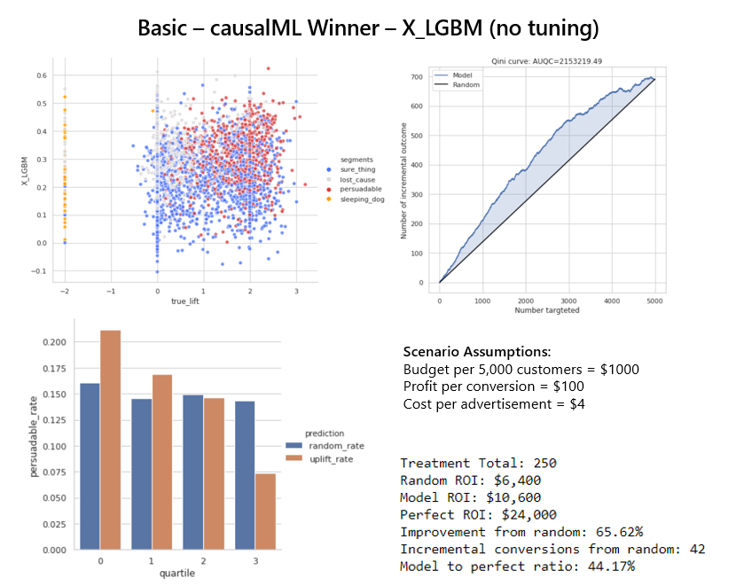
Applied Uplift Modeling with Meta-Learners | Basic CausalML – Winner X-LGBM no tuning
Introduction
Synthetic Data Generation
Uplift Modeling
Conclusions
Performed comparable to from scratch two-model classifier
In hypothetical scenario, demonstrated a 66% improvement to ROI over random
The first quartile of targeting was finding persuadables at a 21% rate (6% greater than the overall distribution 15%)

Slide 19
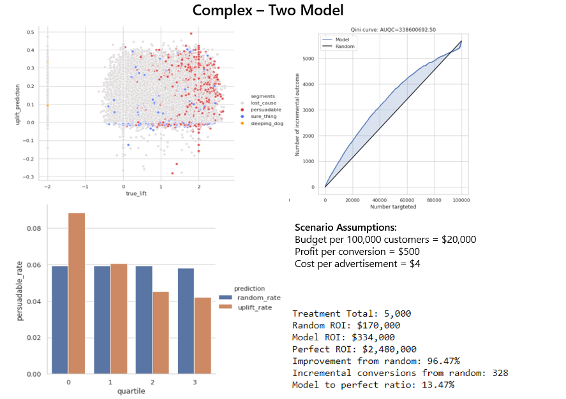
Applied Uplift Modeling with Meta-Learners | Complex (from scratch) Two Model Classifier
Introduction
Synthetic Data Generation
Uplift Modeling
Conclusions
Improved moderately over random targeting
In hypothetical scenario, demonstrated a 96% improvement to ROI over random
The first quartile of targeting was finding persuadables at a 8.5% rate (2.5% greater than the overall distribution 6%)

Slide 20
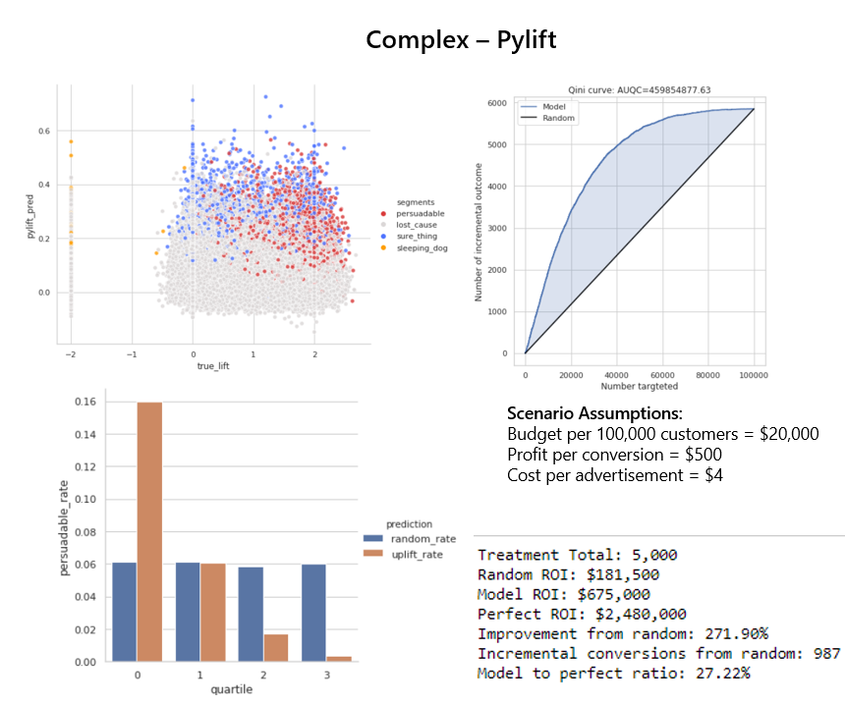
Applied Uplift Modeling with Meta-Learners | Complex Pylift – Transformed Outcome T-Learner w Tuning
Introduction
Synthetic Data Generation
Uplift Modeling
Conclusions
Did significantly better with the complex dataset
In hypothetical scenario, demonstrated a 272% improvement to ROI over random
The first quartile of targeting was finding persuadables at a 16% rate (10% greater than the overall distribution 6%)
Overfitted to conversion signals so probably wouldn’t improve much over propensity

Slide 21
Applied Uplift Modeling with Meta-Learners | Complex Pylift – Transformed Outcome T-Learner w Tuning
Introduction
Synthetic Data Generation
Uplift Modeling
Conclusions
Did significantly better with the complex dataset
In hypothetical scenario, demonstrated a 272% improvement to ROI over random
The first quartile of targeting was finding persuadables at a 16% rate (10% greater than the overall distribution 6%)
Overfitted to conversion signals so probably wouldn’t improve much over propensity

Slide 22
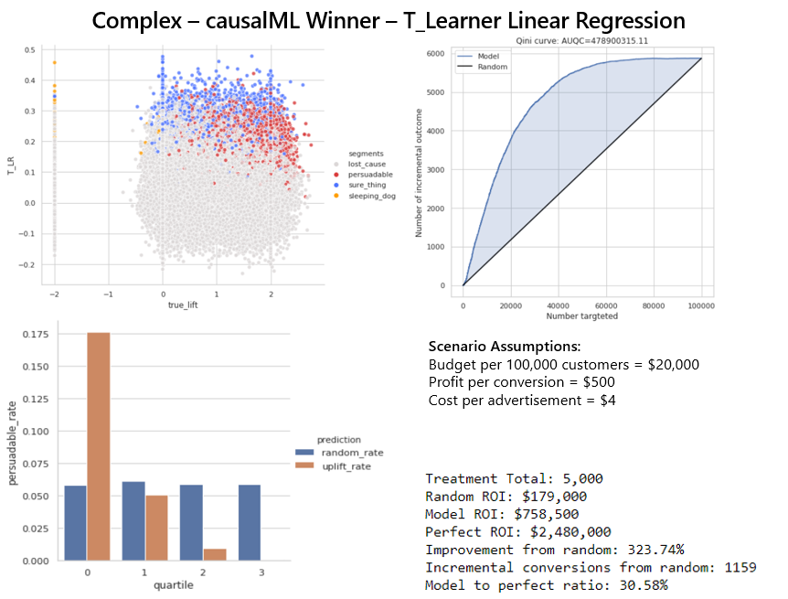
Applied Uplift Modeling with Meta-Learners | Complex CausalML – Winner T-LR no tuning
Introduction
Synthetic Data Generation
Uplift Modeling
Conclusions
Performed the best with complex dataset
In hypothetical scenario, demonstrated a 324% improvement to ROI over random
The first quartile of targeting was finding persuadables at a 17.5% rate (11.5% greater than the overall distribution 15%)

Slide 23
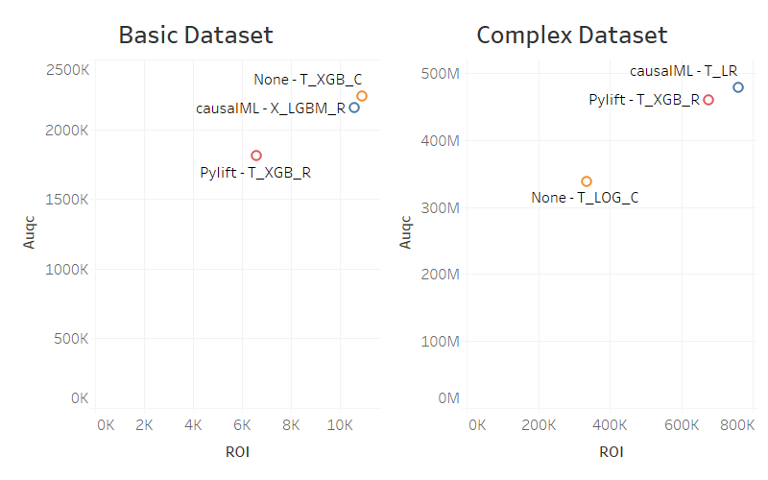

Slide 24
causalML Uplift Trees
Python Uplift Model Playbook
How Big?
Big
>2M rows
Start
Small
<25k rows
<15 features
Large
>100k rows
>100 features
Large-ish
<2M rows
Data
Size
causalML Meta-learners
causalML Meta-learners (Not X)
Four-Quadrant Pyspark
Moderate
25k-99k rows
20 -100 features
Two-Model Classifier
causalML Meta-learners
Heavily tuned Pylift
Slightly tuned Pylift
Two-Model Pyspark
Traditional Propensity Pyspark
Four Quadrant-Approach
Traditional Propensity
Four Quadrant-Approach
Traditional Propensity
Intended to be a loose guideline – results may very
End

Slide 25
Applied Uplift Modeling with Meta-Learners | Takeaways
Introduction
Synthetic Data Generation
Uplift Modeling
Conclusions
In the scenario of a low response and a massive lost causes segment (like the complex dataset), propensity models are going perform strongly since this is the one segment they tend to solve for.
causalML allowing for 4 direct models and 4 meta-learners is a great starting point if your data isn’t PySpark massive
Pylift was pretty good on the complex dataset but not as good as causalML
Just like standard machine learning there is no free lunch– performance is data dependent and you aren’t going to find the optimal features, model, and hyperparameters without a search for them
T-leaner tended to be the best meta-learner for the two datasets considering accuracy, speed, and difficulty to code

Slide 26
Applied Uplift Modeling with Meta-Learners | Further Research
Introduction
Synthetic Data Generation
Uplift Modeling
Conclusions
Try the Four-Quadrant approach and R-learner
In the cross-sell case where the lost cause segment is massive figure out how to better feature select, model select, and hyperparameter tune to maximize incremental purchases and not just overfit the model to conversions
An assessment using even more variety in synthetic datasets
Figuring out how to hyperparameter tune the base regressors in causalML or collaborating with them to get it added
Comparing these results with a traditional propensity model as baseline rather than random

Slide 27
Appendix

Slide 28
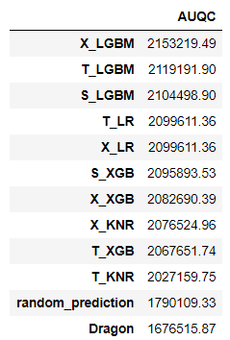
Basic – causalML AUQC for different learners

Slide 29
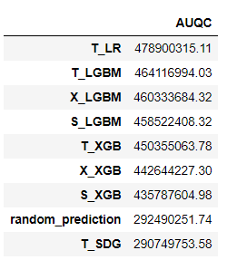
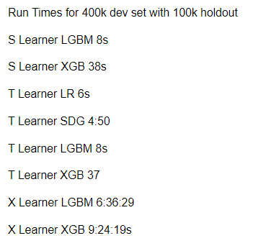
Complex – causalML AUQC for different learners

